Slide 1
ipumsr: IPUMS Data in R
Twin Cities R User Group
February 15, 2018
Greg Freedman Ellis
@gregfreedman
gergness

Slide 2
Why use IPUMS?
What is available?
How to get the data (into R)
Extract system
Loading data
Wrangling value labels
Combining geographic data

Slide 3
Why use IPUMS?
What is available?
How to get the data (into R)
Extract system
Loading data
Wrangling value labels
Combining geographic data

Slide 4
What is IPUMS?
US & International census and survey data
Consistent documentation and standardized data allow for easier comparisons and analyses
Available free of charge
Notes:
\

Slide 5
Why people use IPUMS data
Harmonization and data enhancements
Comprehensive online documentation
Create and download custom data extracts
Online data analysis tools
User support

Slide 6
Example of harmonization
Changes to detail in legal marital status in IPUMS NHIS
Pre-2004 Categories
2004-forward Categories
B = Not in Universe
1 = Married – spouse present
2 = Married – spouse not in household
3 = Married – spouse in household unknown
4 = Widowed
5 = Divorced
6 = Separated
7 = Never Married
B = Not in Universe
1 = Separated
2 = Divorced
3 = Married
4 = Single/Never Married
5 = Widowed

Slide 7
Example of harmonization (cont.)
Harmonization creates comparability between codes in pre-2004 and
2004-forward without losing detail from earlier years.
Harmonized Codes
The first digit of the code is consistent across all years
The second digit of the code contains detail specific to pre-2004 data
00 = Not in Universe
10 = Married
11 = Married – spouse present
12 = Married – spouse not in household
13 = Married – spouse in household unknown
20 = Widowed
30 = Divorced
40 = Separated
50 = Never Married

Slide 8
Additional Enhancements
Interactive variable exploration
Harmonized geography
Consistent industry and occupation coding schemes
Constructed family interrelationship variables

Slide 9
API Access
tidycensus, cancensus, acs and others have all shown how great API access to this kind of data would be for R users
Unfortunately no API yet…
But, we’re working on it! If interested in providing feedback let me know (gfellis@umn.edu)

Slide 10
Colombia: Adolescent Birth Rate
Census 1993
Census 2005
Source: Cuesta and Lovatón (2014)
Data Source: IPUMS-International, Minnesota Population Center

Slide 11
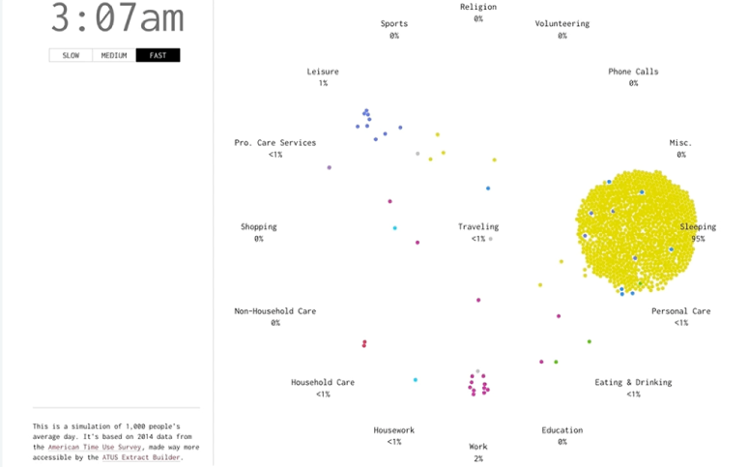
A Day in the Life of Americans
Source: Nathan Yau of Flowing Data
http://flowingdata.com/projects/2015/timeuse-simulation/

Slide 12
Why use IPUMS?
What is available?
How to get the data (into R)
Extract system
Loading data
Wrangling value labels
Combining geographic data

Slide 13

U.S. Census and American Community Survey microdata from 1850 to the present.
(US census data, provides basic information on lots of people)

Slide 14

Current Population Survey microdata including basic monthly surveys and supplements from 1962 to the present.
(US again, fewer people but more details, plus longitudinal component)

Slide 15

Census microdata covering 82 countries from 1960 to the present and historic microdata from the 19th and early 20th centuries for 8 countries.
(Basic information for lots of people from many countries)

Slide 16

Demographic and Health Surveys integrated for analysis across time and space from the 1980s to the present.
(Health survey, usually in countries without infrastructure for a complete census. Focus on maternal and child health)

Slide 17

Health survey data from the National Health Interview Survey from the 1960s to the present and the Medical Expenditure Panel Survey from 1996.
(Large health survey in the US, plus a component recently added to IPUMS on the cost of healthcare)

Slide 18

Historical and contemporary time use data from 1965 to the present.
(Extensive time diary data for respondents in the US and 7 other countries)

Slide 19

Survey data on the science and engineering workforce in the U.S. from 1993 to the present.
(Survey that tracks graduates of STEM programs in US universities)

Slide 20

Tabular U.S. Census data and GIS boundary files from 1790 to the present.
(Summaries of US census data which can provide more geographic detail without compromising anonymity)

Slide 21

Integrated data on population and the environment from 1960 to the present.
(Tools for creating summaries of international census data and connecting to geographic data)

Slide 22
Why use IPUMS?
What is available?
How to get the data (into R)
Extract system
Loading data
Wrangling value labels
Combining geographic data

